Slide 1

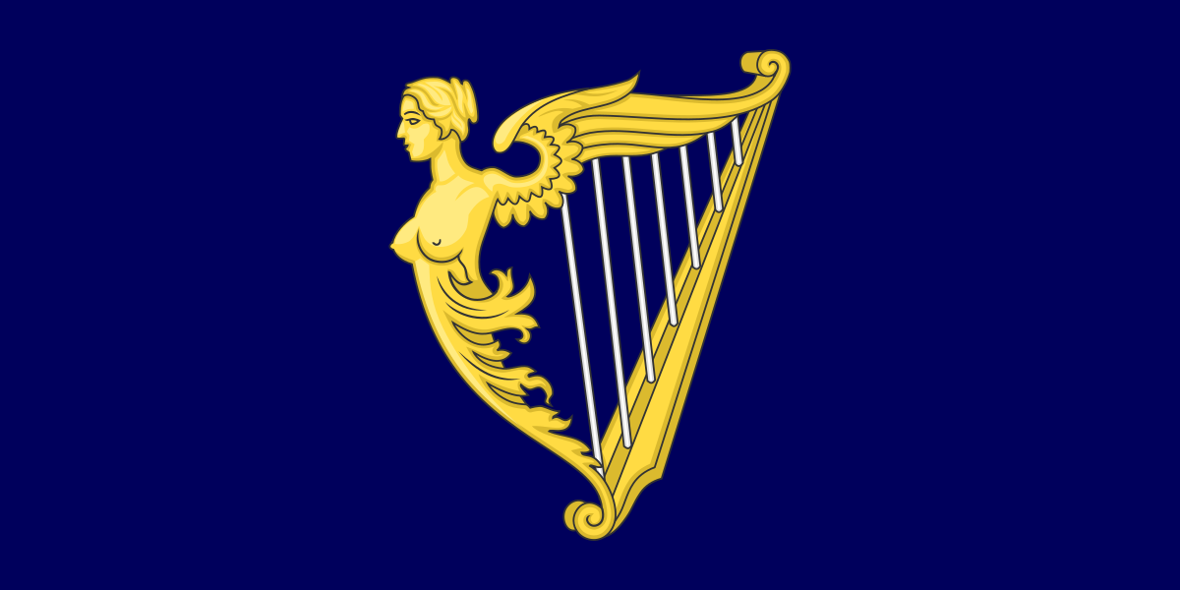


1500 to 1680
Chapter 11
THE IRISH PLANTATIONS
the irish plantations
Strand Two: The History of Ireland
@MsDoorley

Slide 2
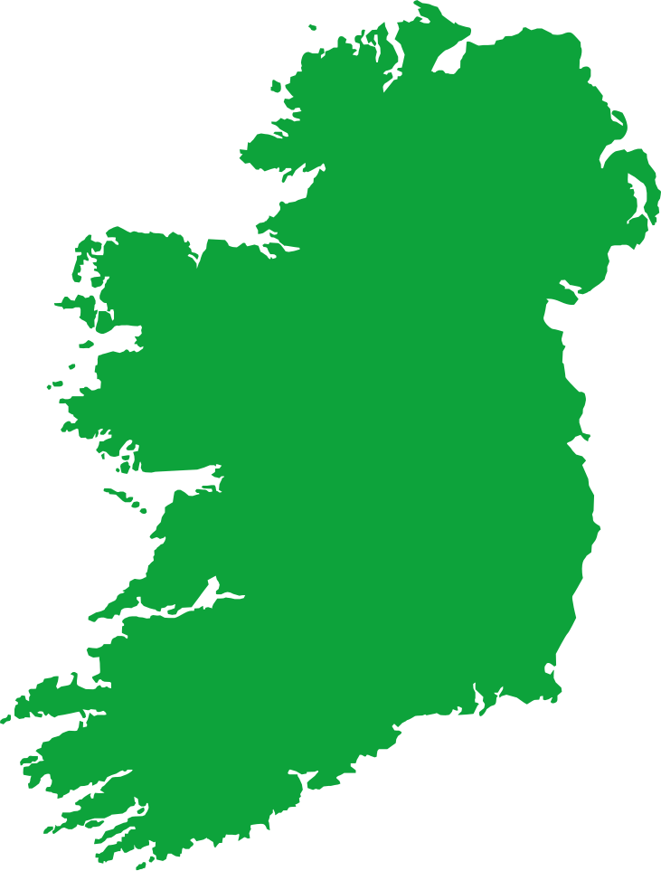
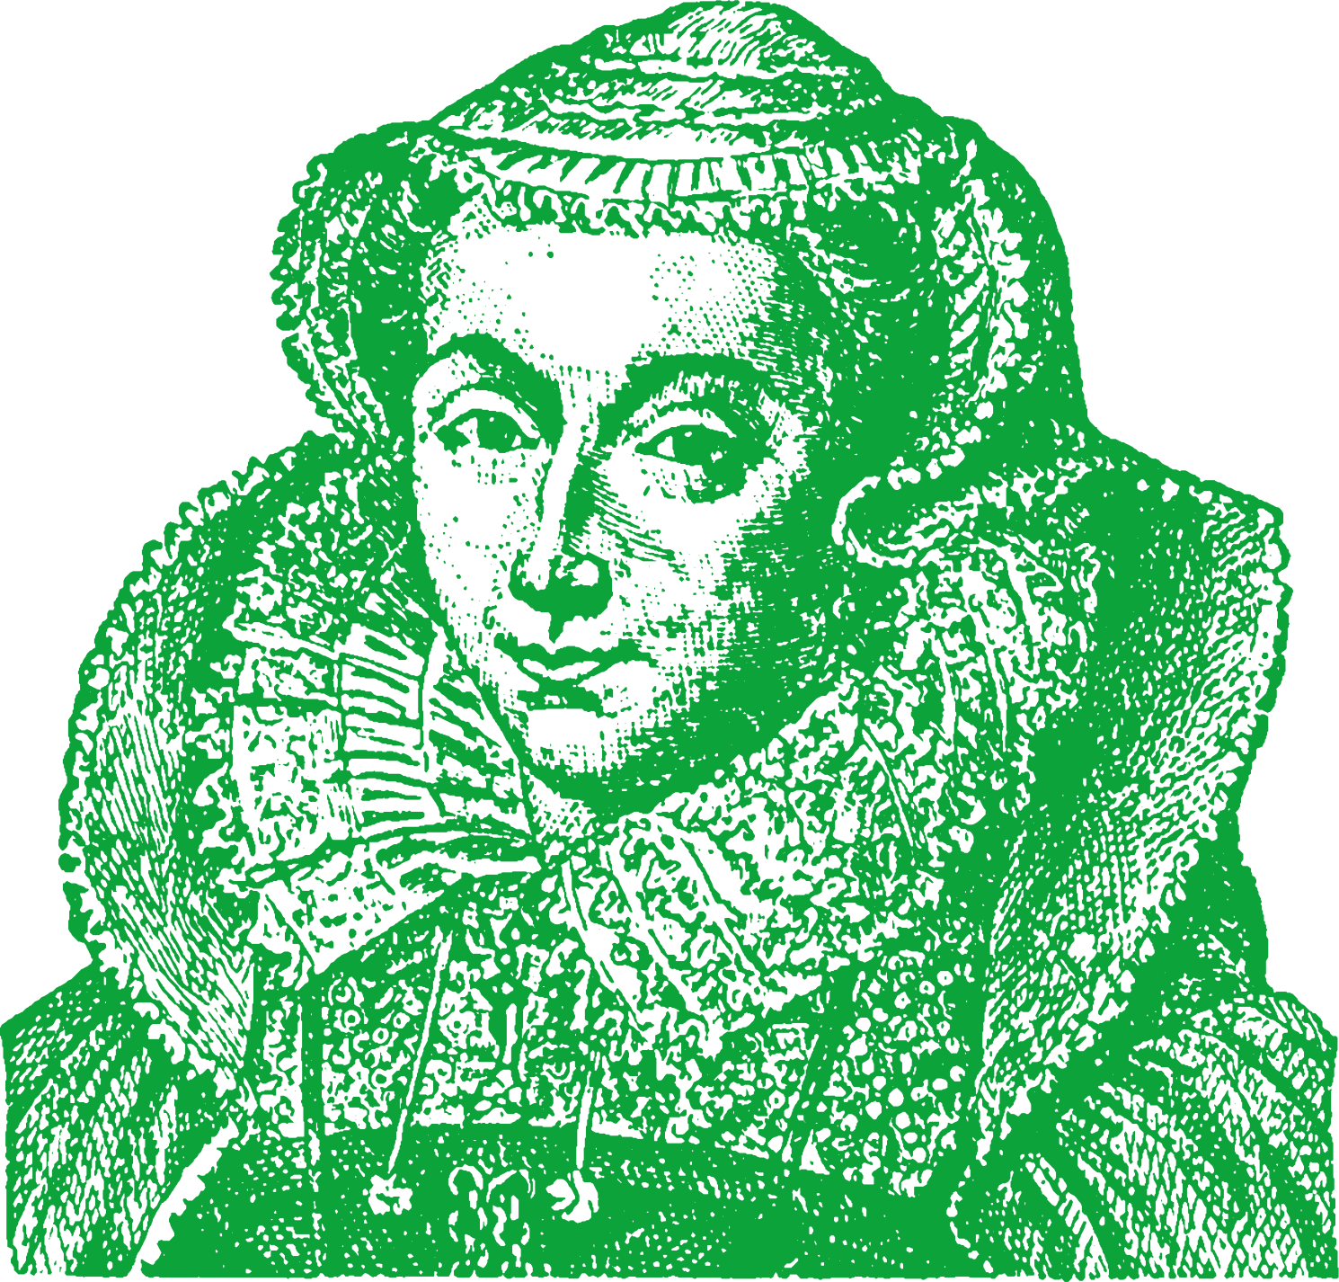
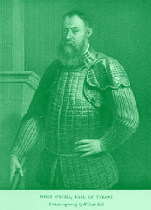
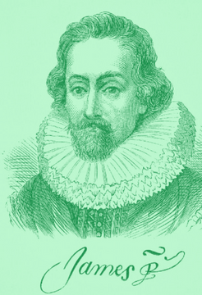
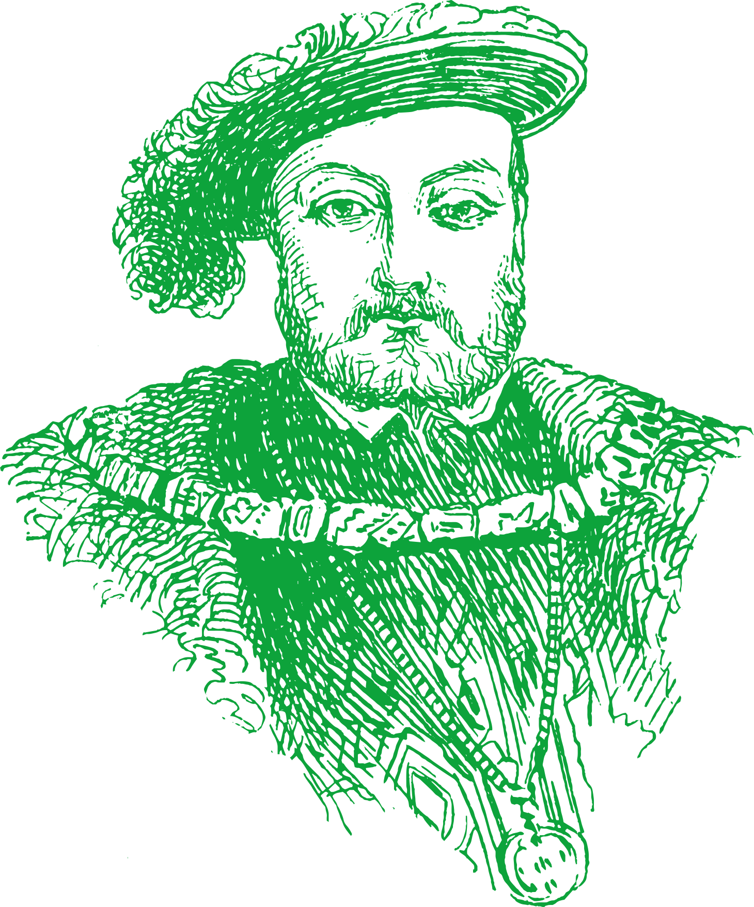
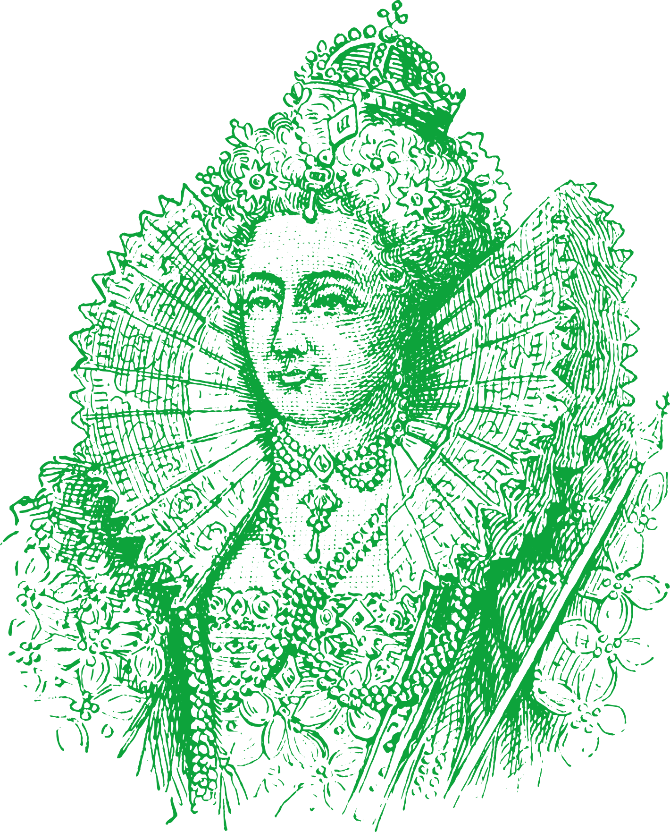
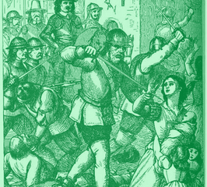
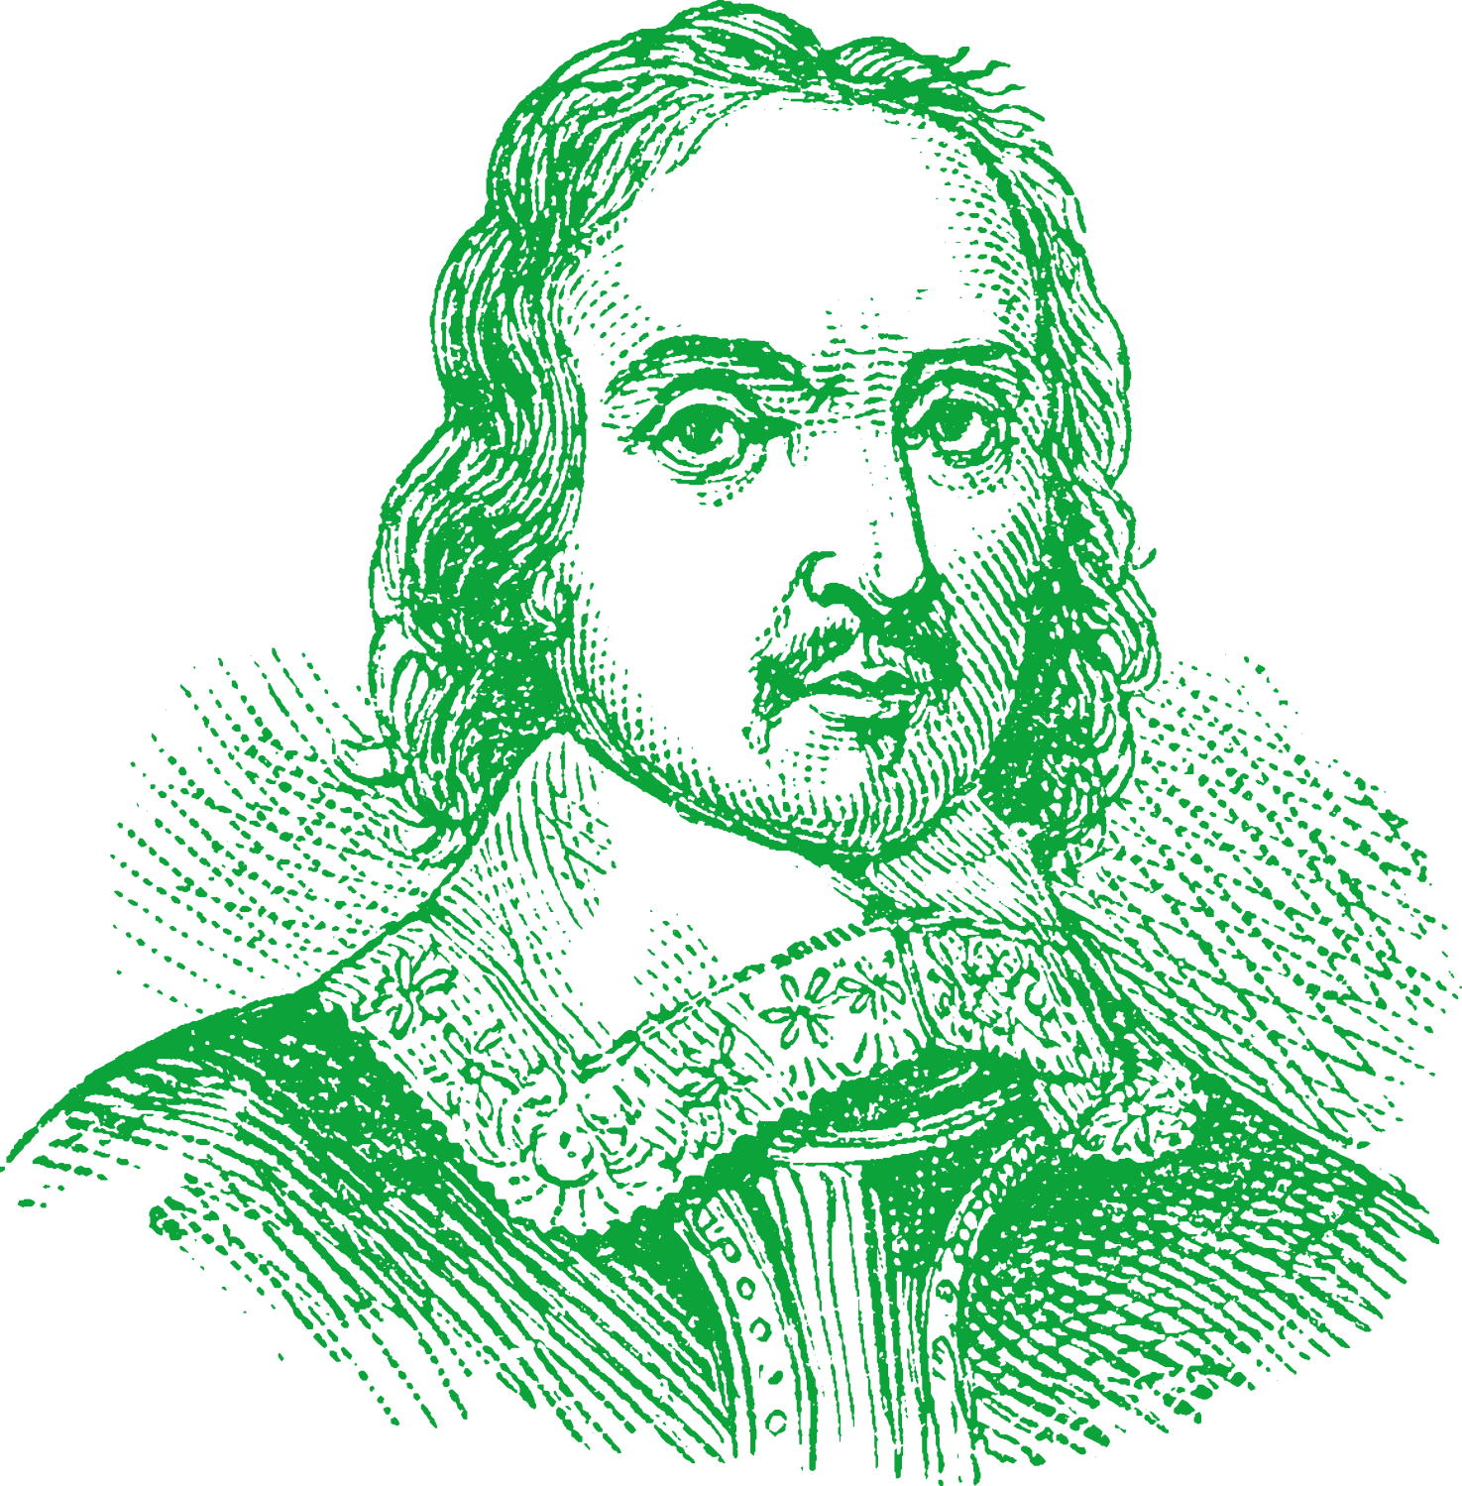
Chapter 11
THE IRISH PLANTATIONS
Queen Mary I orders the Plantation of Laois and Offaly, confiscating the land of the O'Moores and O'Connors
Battle of Kinsale
Hugh O'Neill and the Spanish Armada fail against the army of Queen Elizabeth I
King James I orders the Plantation of Ulster, the only successful plantation
Strand Two: The Nature of History
Chapter Eleven: The Irish Plantations
1537
1557
1583
1601
1607
1609
1652
Surrender and Regrant
Henry VIII sends first English Protestants to Ireland
Queen Elizabeth I orders the Plantation of Munster after two failed Desmond Rebellions
The Flight of the Earls
Hugh O'Neill and Rory O'Donnell flee Ireland but die in exile.
Oliver Cromwell confiscates Irish land and confides Irish Catholics to Connaught
@MsDoorley

Slide 3
Learning Outcomes
  2.1 RECOGNISE how a pattern of settlement and plantation influenced identity on the island of Ireland, referring to one example of a pattern of settlement, such as the growth of towns, and one plantation
  1.2 CONSIDER contentious or controversial issues in history from more than one perspective and discuss the historical roots of a contentious or controversial issue or theme in the contemporary world
  1.7 DEVELOP historical judgements based on evidence about personalities, issues and events in the past, showing awareness of historical significance
Strand Two: The History of Ireland
Chapter Eleven: The Irish Plantations
@MsDoorley

Slide 4
Introduction
The Plantations is the name given to the period of Irish history when, in the sixteenth and seventeenth centuries, Irish land was confiscated by the English Crown and then colonised by British settlers. The Plantation set in motion major changes to Ireland and also influence identity on the island in a lasting way. The roots of many recent events in Irish history date from this period.
Strand Two: The History of Ireland
Chapter Eleven: The Irish Plantations
@MsDoorley

Slide 5
1500 to 1680
Chapter 11
11.1: IRELAND IN THE 1500S
11.1: ireland in the 1500s
In the 1500s, Ireland was home to three major groups of people: The Old English, the Anglo-Irish and the Gaelic Irish. In theory, the English Crown ruled Ireland – but in reality, power in Ireland rested with these groups.
Strand Two: The History of Ireland
@MsDoorley

Slide 6
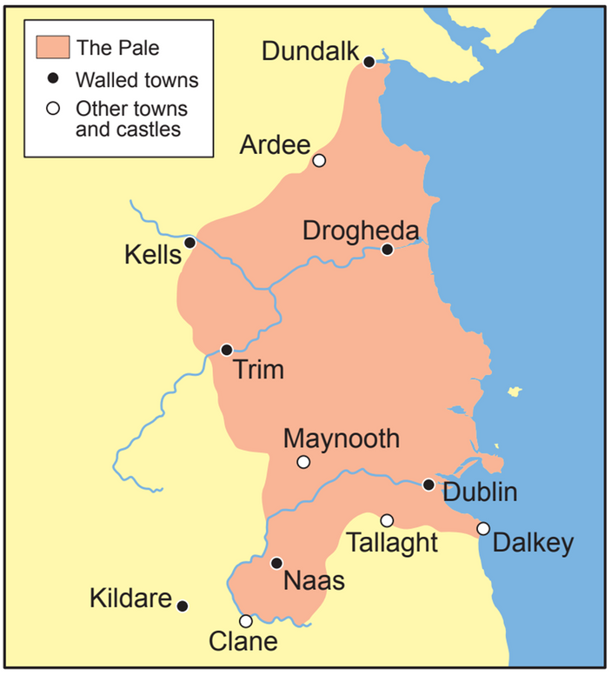
The Old English
In medieval times Dublin and its surrounding areas (known as the Pale) became the base of English power in Ireland. In the Pale, the English language, customs, dress, farming methods (mainly crop farming) and laws were practised.
  By the early 1500s, the people who lived in the Pale were mainly English merchants. They were known as the Old English (people living in the Pale who were loyal to the king).
  The Reformation in England had a big impact on Ireland from the 1550s onwards. It led to an increase in tension between the Gaelic Irish and the Old English who lived in the Pale.
Strand Two: The History of Ireland
Chapter Eleven: The Irish Plantations
Diagram taken from Artefact, 2nd Edition by Eimear Jenkinson and Gregg O'Neill (educate.ie)
@MsDoorley

Slide 7
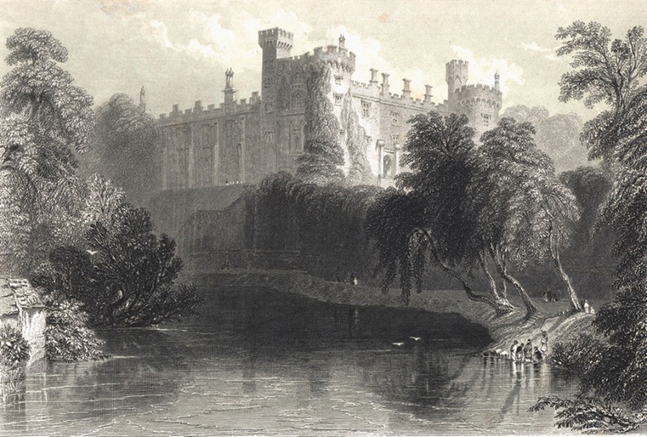
The Anglo-Irish
The Anglo-Irish were descendants of the Anglo-Normans who had invaded Ireland in the twelfth century.
  They were also known as the Gaelicised Anglo-Normans because they followed a combination of English and Irish laws and traditions.
  By the 1500s, they had become independent of the English Crown. Examples of powerful Anglo-Irish families were: Fitzgeralds of Kildare (Maynooth); Butlers of Ormond (Kilkenny); Fitzgeralds of Munster (Listowel)
  From 1468 onwards, the Lord Deputy (King’s representative in Ireland) was from an Anglo-Irish family.
Strand Two: The History of Ireland
Chapter Eleven: The Irish Plantations
Diagram taken from Artefact, 2nd Edition by Eimear Jenkinson and Gregg O'Neill (educate.ie)
@MsDoorley

Slide 8
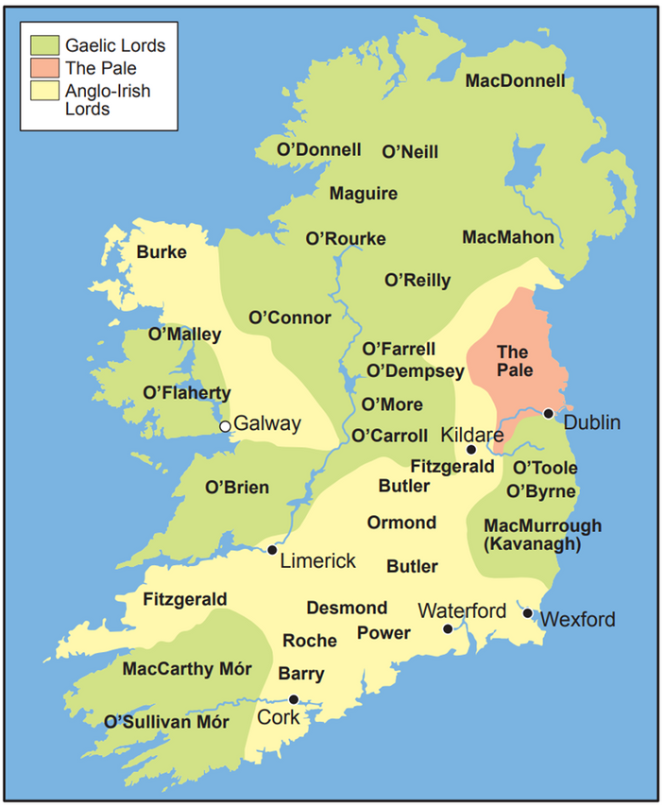
The Gaelic Irish
The Gaelic Irish were the Gaelic chieftains who followed Irish law (Brehon law).
  The Brehon laws were Gaelic Irish laws dating from the Iron Age. The laws were a civil rather than a criminal code. They dealt with fines for harm caused and rules about property, leadership, marriage and other contracts.
  The Gaelic Irish did not recognise the English king as ruler of Ireland.
  They feared that the Crown would try to expand its control over Ireland – they disliked and attacked English settlers for this.
  Examples of powerful Gaelic Irish families (clans) included the O’Neills of Tyrone, the O'Donnells of Donegal and the O’Connors of Offaly.
Strand Two: The History of Ireland
Chapter Eleven: The Irish Plantations
Diagram taken from Artefact, 2nd Edition by Eimear Jenkinson and Gregg O'Neill (educate.ie)
@MsDoorley

Slide 9
Differences in Law
Brehon Law (Gaelic Irish) | English Common Law (the Pale)
Courts held on hillsides | Courts held in courthouses
No jails or executions. Fines used as punishments | Harsh jail sentences and death by hanging given as punishments
Wealth measured by number of cattle owned | Wealth measured in monetary terms
Divorce allowed | Divorce forbidden
A wife kept her own name, wealth and property | A wife took her husband’s name, and her property and wealth became his
Children born outside marriage were entitled to a share of their father’s wealth or property | Children born outside marriage could not inherit any of their father’s wealth or property
Strand Two: The History of Ireland
Chapter Eleven: The Irish Plantations
@MsDoorley

Slide 10
Checkpoint pg. 29 (Artefact, 2nd Edition)
  Explain the terms: the Pale, Old English, Anglo-Irish and Gaelic Irish.
  Name two powerful Anglo-Irish families and two powerful Gaelic Irish families.
  What was Brehon law?
  Why do you think the Gaelic Irish resisted English law?
  Why do you think the tensions between the Gaelic Irish and the English in the Pale increased?
Strand Two: The Nature of History
Chapter Eleven: The Irish Plantations
@MsDoorley

Slide 11
Checkpoint pg. 29 (Artefact, 2nd Edition)
  The Plantations: Irish land was confiscated by the English Crown and then colonised by British settlers; The Pale: the area around Dublin directly under the control of the English Crown; Anglo-Irish: descendants of the Anglo-Normans who had invaded Ireland in the twelfth century; Gaelic Irish: the Gaelic chieftains who followed Irish laws (known as Brehon law).
  Anglo-Irish families: any two of: the Fitzgeralds of Kildare, the Butlers of Ormond/Kilkenny and the Fitzgeralds of Munster; Gaelic Irish families: any two of: the O’Neills of Tyrone, the O’Donnells of Donegal and the MacCarthys of Cork.
  3. Brehon law was a set of Gaelic Irish laws dating back as far as the Iron Age. The laws were a civil rather than a criminal code.
  The Gaelic Irish resisted the English laws because they reflected the values of a different society and would involve such things as: harsh jail sentences and death by hanging given as punishments, divorce being forbidden, etc.
  Tensions increased because the Gaelic Irish feared that the Crown would try to expand its control over Ireland and therefore disliked and attacked English settlers.
Strand Two: The Nature of History
Chapter Eleven: The Irish Plantations
@MsDoorley

Slide 12
1500 to 1680
Chapter 11
11.2: THE TUDORS AND IRELAND
11.2: the tudors and ireland
Strand Two: The History of Ireland
@MsDoorley

Slide 13
Henry VIII and the Tudors
Henry VII came to power in England in 1485, beginning the Tudor Era. His son, Henry VIII, became king after his father’s death and ruled between 1509 and 1547. Henry VIII and his three heirs – Edward VI, Mary I and Elizabeth I – gradually conquered Ireland through policies such as ‘surrender and regrant’ and plantation. After the death of his older brother in 1502, Henry married his brother’s widow, Catherine of Aragon, with special permission from the Pope. They would have a daughter, Mary I, but Henry still needed a male heir and his wife was now in her forties. He wanted Pope Clement VII to annul (cancel) his marriage however, this would be a problem as the Church would have had to admit that it was wrong to ever give permission as well as angering Catherine’s nephew, the Holy Roman Emperor, Charles V which could risk another war.
Henry VIII wanted to marry his mistress, Anne Boleyn (Catherine’s former lady’s maid), who was pregnant (their child later becoming Queen Elizabeth I). In 1533, with the Reformation gaining momentum in Europe, Henry VIII broke with the Church and married Anne Boleyn. He was excommunicated as a result. This would mark the beginning of the English Reformation and resulted in England becoming a Protestant monarchy. Henry VIII declared himself the Head of the Church (Act of Supremacy 1534), closed down monasteries and confiscated the Catholic Church’s lands (Act of Dissolution 1536).
Henry went on to have six wives in total and three children: Catherine of Aragon (mother of Mary I) - divorced, Anne Boleyn (mother of Elizabeth I) - divorced and beheaded, Jane Seymour (mother of Edward VI) - died after childbirth, Anne of Cleves - divorced, Catherine Howard - beheaded, Catherine Parr - survived.
Strand Two: The History of Ireland
Chapter Eleven: The Irish Plantations
@MsDoorley

Slide 14
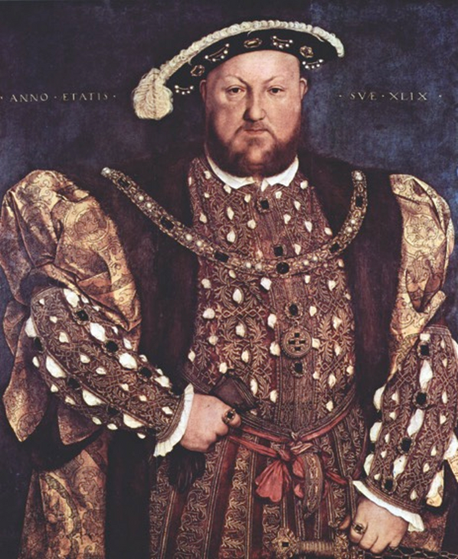
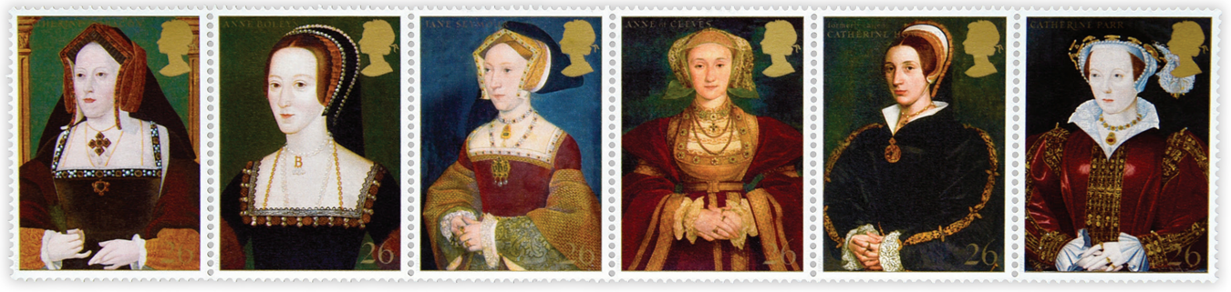
Strand Two: The History of Ireland
Chapter Eleven: The Irish Plantations
Diagram taken from Artefact, 2nd Edition by Eimear Jenkinson and Gregg O'Neill (educate.ie)
@MsDoorley

Slide 15
The Tudors and Ireland
The Tudors had many reasons for wanting to fully conquer Ireland:
  To expand their territory. The Crown only had full control over the Pale.
  To spread English customs, culture, laws and so forth. These were seen as superior to those of the Gaelic Irish, who were portrayed as being barbaric and unable to look after themselves. e
  To spread their new religion. They believed that they could enforce Protestantism in Ireland.
  To prevent the Catholic Irish forming an alliance with other Catholic countries. These other countries included Spain and France who would use Ireland as a base to attack England.
  To prevent further rebellions. The Fitzgerald rebellion of 1534 was begun by the Lord Deputy’s own son ‘Silken’ Thomas Fitzgerald.
  Hearing the rumour that his father had been beheaded in London by Henry VIII, Silken Thomas attempted to rally the lords of the Pale and even attacked Dublin Castle.
  To save money. Planting soldiers in Ireland would be cheaper in the long term rather than paying soldiers to protect the English already in Ireland.
Strand Two: The History of Ireland
Chapter Eleven: The Irish Plantations
@MsDoorley

Slide 16
Surrender and Regrant
Henry VIII initially attempted to control Ireland by peaceful means, through a policy called surrender and regrant. This meant that Anglo-Irish and Gaelic Irish rulers surrendered themselves and their lands to Henry VIII and, in return, he would grant their land back to them along with an English title.
  Titles such as earl, lord and baron were given.
  Local rulers acknowledged and accepted that Henry VIII as King of Ireland, had a legal right to their land and was owed their loyalty and allegiance.
  Henry VIII could confiscate the lords’ land if their behaviour angered him.
  Land was now passed directly from father to son through the English system of succession.
  Increased wealth and power for certain families.
Strand Two: The History of Ireland
Chapter Eleven: The Irish Plantations
@MsDoorley

Slide 17
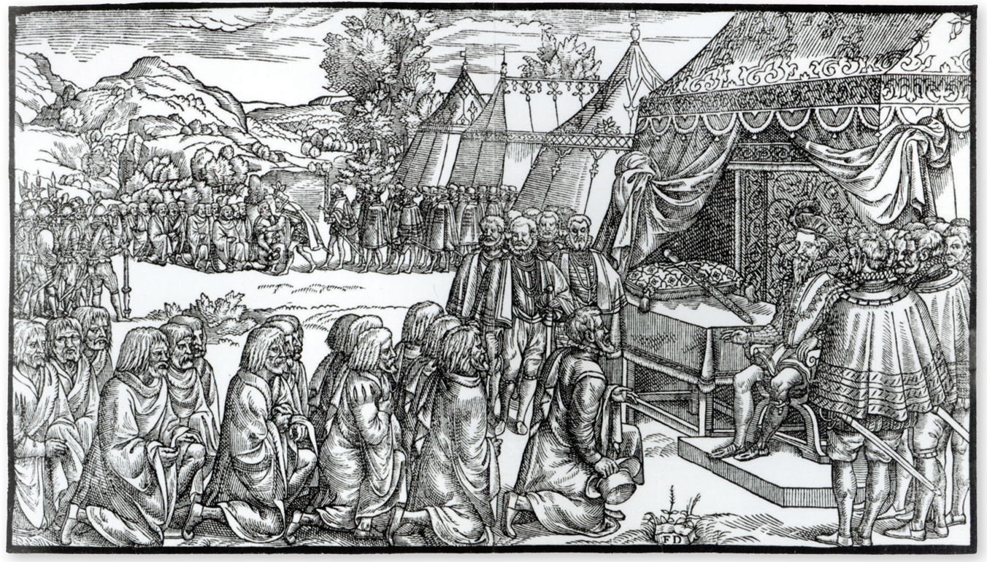
Strand Two: The History of Ireland
Chapter Eleven: The Irish Plantations
Diagram taken from Artefact, 2nd Edition by Eimear Jenkinson and Gregg O'Neill (educate.ie)
@MsDoorley

Slide 18
The policy of plantation
When Irish land was confiscated by the King, it could be sold or rented to loyal English settlers (plantation).
  The new settlers on the land were known as planters.
  The planters would spread English customs and laws.
  They would defend the land from the Gaelic Irish.
  They would also spread the religion of the English Crown.
Strand Two: The History of Ireland
Chapter Eleven: The Irish Plantations
@MsDoorley

Slide 19
Checkpoint pg. 118 (Artefact, 2nd Edition)
  Why did Henry VIII break with the Church in Rome?
  What were the Act of Supremacy and the Act of Dissolution?
  Name Henry VIII’s three heirs.
  List three reasons why the Tudors wanted to conquer Ireland.
  Explain the terms surrender and regrant, and plantation.
Strand Two: The Nature of History
Chapter Eleven: The Irish Plantations
@MsDoorley

Slide 20
Checkpoint pg. 118 (Artefact, 2nd Edition)
1. Henry VIII broke with the Church so that he could divorce his wife, Catherine of Aragon, and marry Anne Boleyn. Henry was excommunicated by the Pope and declared himself Head of the Church in England. This marked the beginning of the English Reformation and resulted in England becoming a Protestant monarchy.
2. Act of Supremacy: when Henry VIII declared himself the Head of the Church in 1534.
3. Mary I, Elizabeth I and Edward VI.
4. Any three of: to expand their territory; to spread English customs, culture and laws; to spread their new religion; to prevent the Catholic Gaelic Irish forming an alliance with other Catholic countries; to prevent further rebellions; to save money.
5. Surrender and regrant: the Anglo-Irish and the Gaelic Irish rulers were to surrender themselves and their lands to Henry VIII, and he would grant their land back to them, along with an English title.
Strand Two: The Nature of History
Chapter Eleven: The Irish Plantations
@MsDoorley

Slide 21
1500 to 1680
Chapter 11
11.3: THE EARLY PLANTATIONS
11.3: the early plantations
Henry VIII’s son, Edward VI, became king in 1547. However, Edward was only nine then and his health was never strong.
Edward died in 1553 of tuberculosis and was succeeded by his oldest half-sister, Mary. Queen Mary I had remained Catholic like her mother, Catherine of Aragon.
Strand Two: The History of Ireland
@MsDoorley

Slide 22
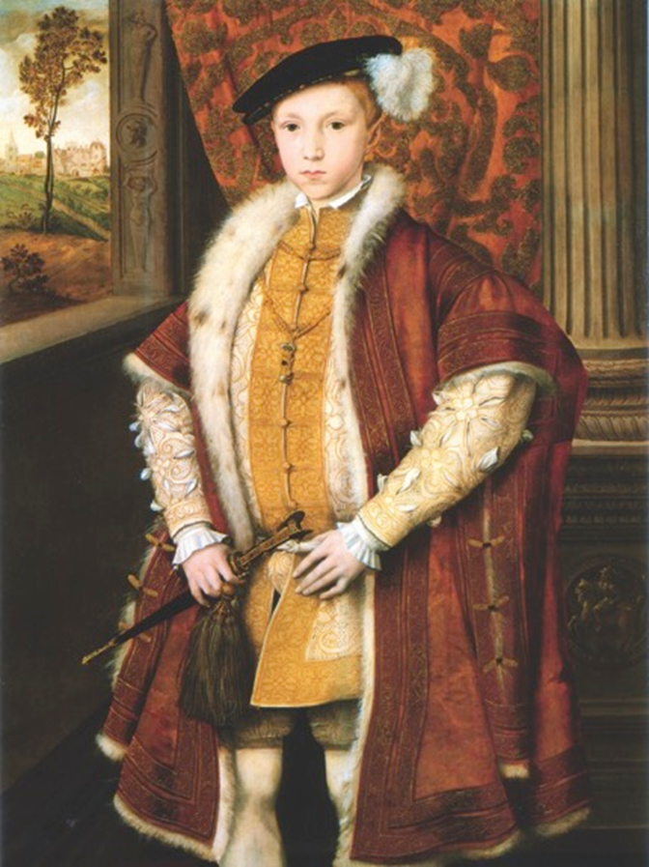
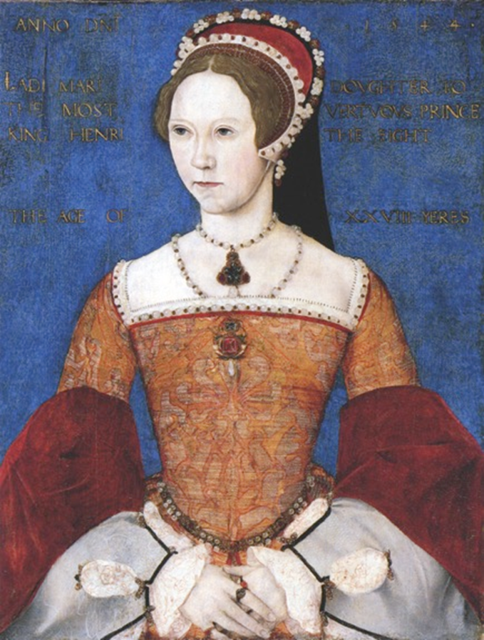
Strand Two: The History of Ireland
Chapter Eleven: The Irish Plantations
Diagram taken from Artefact, 2nd Edition by Eimear Jenkinson and Gregg O'Neill (educate.ie)
@MsDoorley

Slide 23
The Laois-Offaly Plantations
The O’Moores and the O’Connors were the Gaelic Irish lords of Laois and Offaly in the sixteenth century. They raided the Pale frequently, mainly for cattle. Queen Mary I sent her Lord Deputy to confiscate the O’Moore and O’Connor lands as punishment. A plantation of the O’Moore and O’Connor lands was then organised.
  Laois and Offaly were renamed Queen’s County and King’s County.
  Each county was assigned a sheriff to enforce English laws and customs.
  The towns of Portlaoise and Daingean were renamed Maryborough and Philipstown, after Mary and her husband, Phillip II of Spain.
  The confiscated land was divided into estates (large farms) of between 350 and 1,000 acres.
  Land was given to Englishmen born in England or Ireland.
  English-style houses had to be built.
Strand Two: The History of Ireland
Chapter Eleven: The Irish Plantations
@MsDoorley

Slide 24
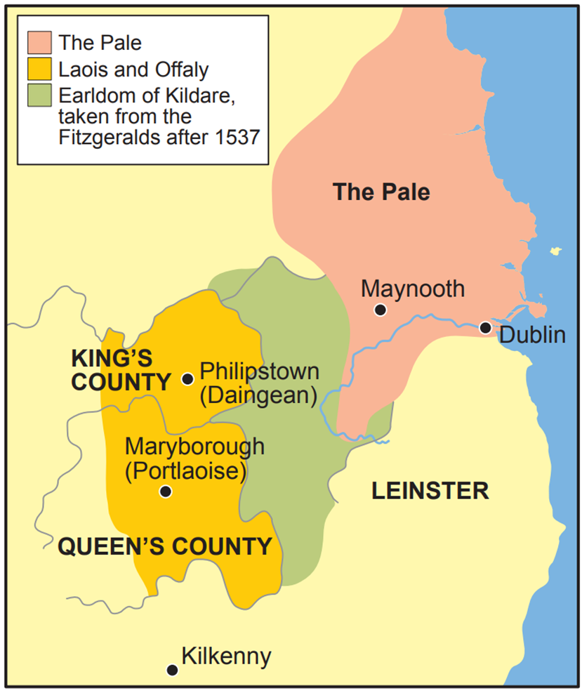
The Results of the Laois-Offaly Plantations
•It was a failure.
•It did not attract enough planters from England.
•Gaelic planters had to be given land.
•English customs and laws did not flourish.
•The confiscated lands were still attacked.
•It led to better planning in future plantations.
Strand Two: The History of Ireland
Chapter Eleven: The Irish Plantations
Diagram taken from Artefact, 2nd Edition by Eimear Jenkinson and Gregg O'Neill (educate.ie)
@MsDoorley

Slide 25
The Munster Plantation
Queen Mary I died in 1558, without any heirs. Her younger half-sister Elizabeth I then became Queen of England and ruled for forty-four years. Famously, Elizabeth never married and also died without heirs, making her the last Tudor.
Much of sixteenth-century Munster was ruled by the Fitzgerald's of Desmond, a Catholic Anglo-Irish family. Queen Elizabeth I was Protestant like her mother, Anne Boleyn. Elizabeth encouraged Englishmen known as ‘adventurers’ to claim land in Munster (men who claimed to be descendants of the early Normans who had been granted land in Munster by Henry II). Elizabeth also appointed presidents, men who imposed English law, the English language and the Protestant religion – she wanted to make Ireland as Protestant as England.
Strand Two: The History of Ireland
Chapter Eleven: The Irish Plantations
@MsDoorley

Slide 26
The Two Desmond Rebellions
The Irish lords were angered by Elizabeth’s actions that resulted in what are known as the two Desmond Rebellions.
  The first was led by James Fitzmaurice Fitzgerald, a cousin of the Earl of Desmond, in 1569. It was put down easily and Fitzgerald fled to Europe.
  The second, in 1579, began when Fitzgerald returned to Ireland with soldiers sent by Pope Gregory XIII. He was soon killed but his cousin took over. The Earl and his forces were finally defeated in 1583 and his head was sent to Queen Elizabeth with the rest of his body displayed in Cork as an example.
Strand Two: The History of Ireland
Chapter Eleven: The Irish Plantations
@MsDoorley

Slide 27
Consequences of the Desmond Rebellions
The Desmond lands were given to undertakers, men who undertook (agreed) to do as they were told with the land given to them. The agreements included to:
  Split the land into enormous estates of 4,000 – 12,000 acres.
  Only hire English farmers, labourers and craftsman.
  Bring their own tenants, servants, sheep, cattle and horses from England.
  Pay rent to the Crown.
  Spread Protestantism and English laws and customs.
  Be prepared for Catholic attacks, including a possible Spanish invasion, by constructing defences.
  Completely remove the Gaelic Irish from the land.
Strand Two: The History of Ireland
Chapter Eleven: The Irish Plantations
@MsDoorley

Slide 28
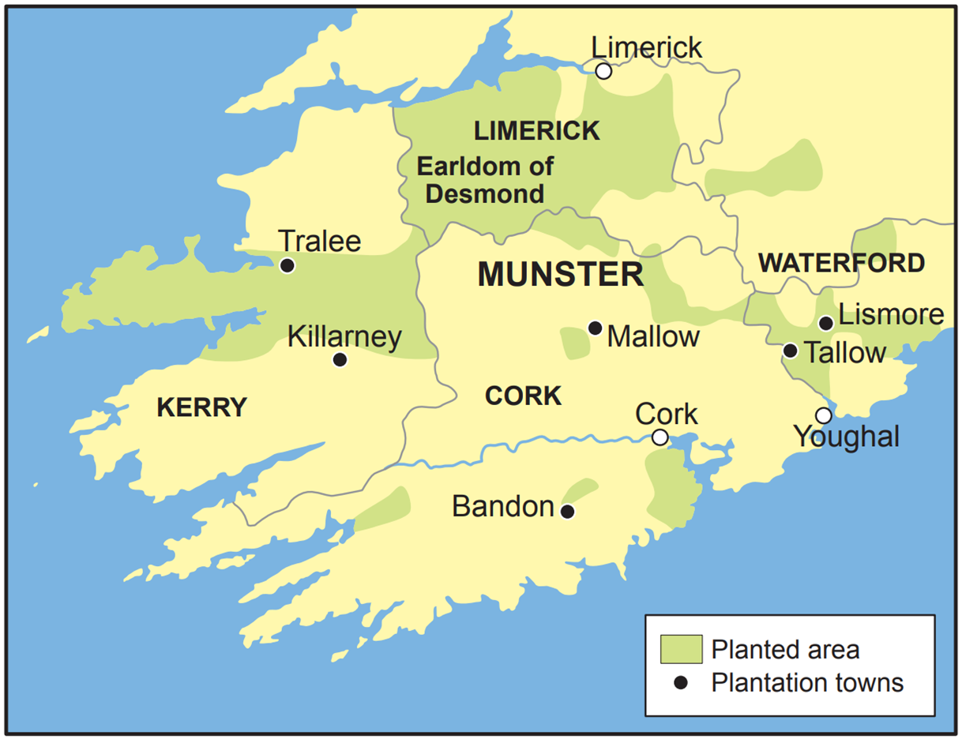
Strand Two: The History of Ireland
Chapter Eleven: The Irish Plantations
Diagram taken from Artefact, 2nd Edition by Eimear Jenkinson and Gregg O'Neill (educate.ie)
@MsDoorley

Slide 29
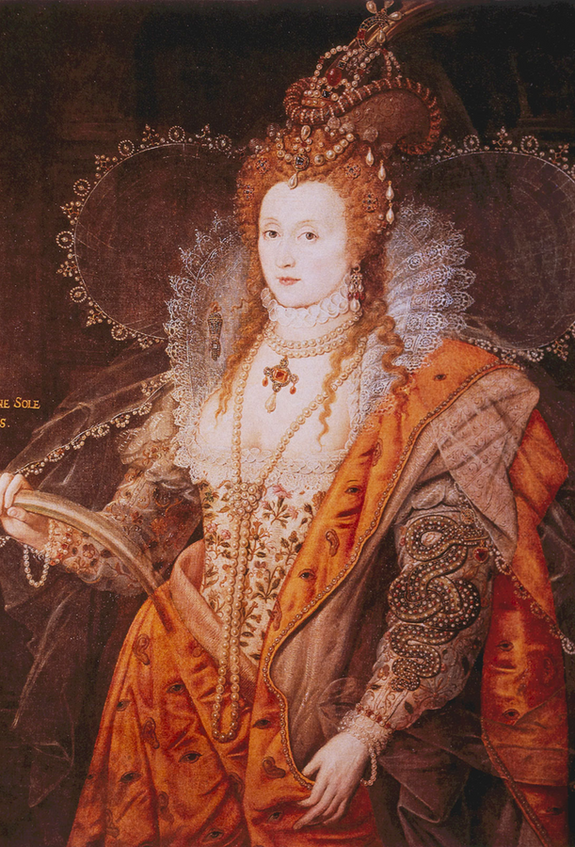
Queen Elizabeth I, 1533-1603
Queen Elizabeth was Queen of England and Ireland from 1558 until her death in 1603. She strengthened the Church of England, which remains to this day. Elizabeth's reign became known as the Elizabethan Era. She defeated the Spanish Armada in 1588 and also survived several attempts to overthrow her reign as women were seen as being inferior to men, especially in relation to intelligence and strength. Elizabeth was the last of the five Tudor Monarchs when she died in 1603 without any heirs, marking the end of the Tudor dynasty that had existed for 118 years. The son of her former rival and cousin, Mary Queen of Scots, succeeded her on the throne as James I, marking the beginning of the Stuart dynasty. Elizabeth I is described by historians as one of England's greatest monarchs.
Strand Two: The History of Ireland
Chapter Eleven: The Irish Plantations
Diagram taken from Artefact, 2nd Edition by Eimear Jenkinson and Gregg O'Neill (educate.ie)
@MsDoorley

Slide 30
The Results of the Munster Plantation
  The Crown had hoped for 20,000 settlers but only one-fifth of that number went.
  They still had to rent to the Gaelic Irish.
  The Gaelic Irish continued to attack the plantations.
  New towns were set up (e.g. Killarney, Lismore, Youghal, Mallow and Bandon).
  New farming methods were brought to Ireland; tillage (crop farming) grew in popularity.
  New trades came to Ireland such as coopering (making timber barrels)
  Lessons were learned for future plantations.
Strand Two: The History of Ireland
Chapter Eleven: The Irish Plantations
@MsDoorley

Slide 31
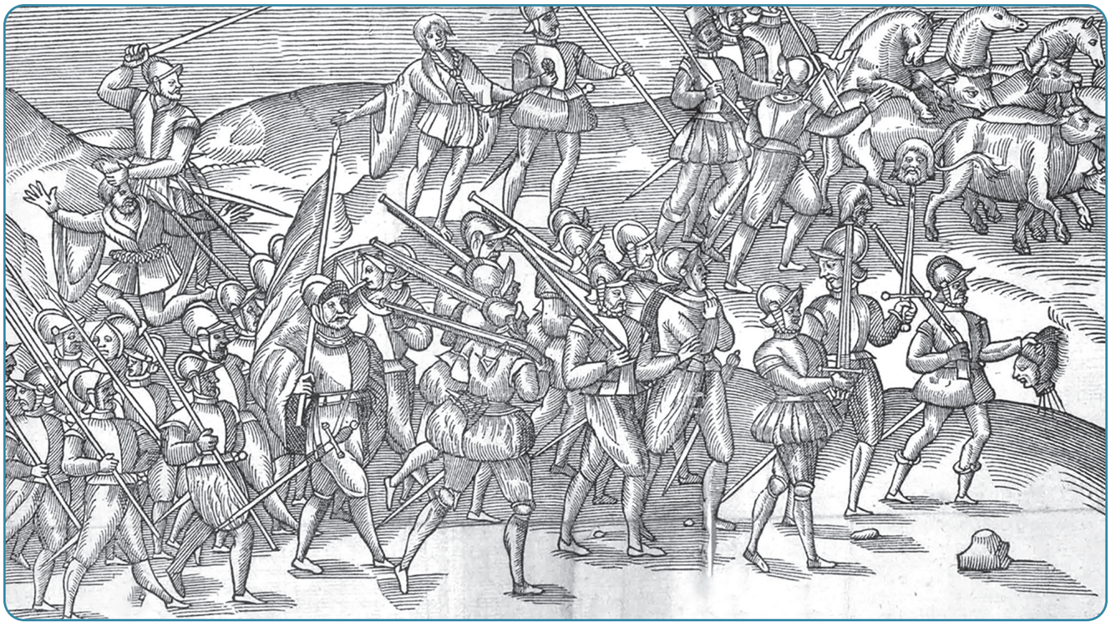
Strand Two: The History of Ireland
Chapter Eleven: The Irish Plantations
Diagram taken from Artefact, 2nd Edition by Eimear Jenkinson and Gregg O'Neill (educate.ie)
@MsDoorley

Slide 32
Checkpoint pg. 118 (Artefact, 2nd Edition)
  In what century did the Laois-Offaly Plantation and the Munster Plantation take place?
  Explain the terms: adventurer, president and undertaker.
  Which Queens were responsible for each plantation?
  List two results of each of the plantations.
  Why do you think the early plantations failed? Give three reasons in each case.
Strand Two: The Nature of History
Chapter Eleven: The Irish Plantations
@MsDoorley

Slide 33
1500 to 1680
Chapter 11
11.4: THE ULSTER PLANTATION
11.4: the ulster plantation
Strand Two: The History of Ireland
@MsDoorley

Slide 34
Background to the Ulster Plantation
Ulster was dominated by Gaelic Irish clans, especially the powerful O’Neills of Tyrone and the O’Donnells of Donegal. Queen Elizabeth had hoped to control Ulster in two ways;
  By kidnapping Red Hugh O’Donnell and blackmailing his family to accept English rule.
  By giving Hugh O’Neill the title of ‘Earl of Tyrone’ and he had been loyal to her.
However, Elizabeth’s policy of planting adventurers and sheriffs in Ulster to enforce Protestantism and English customs angered Hugh O’Neill. They turned to the Catholic King Phillip II of Spain (who had been Queen Mary I’s husband) for help to defend Ulster from Protestantism; Phillip sent no troops but Ulster chiefs rebelled in 1594 regardless.
Strand Two: The History of Ireland
Chapter Eleven: The Irish Plantations
@MsDoorley

Slide 35
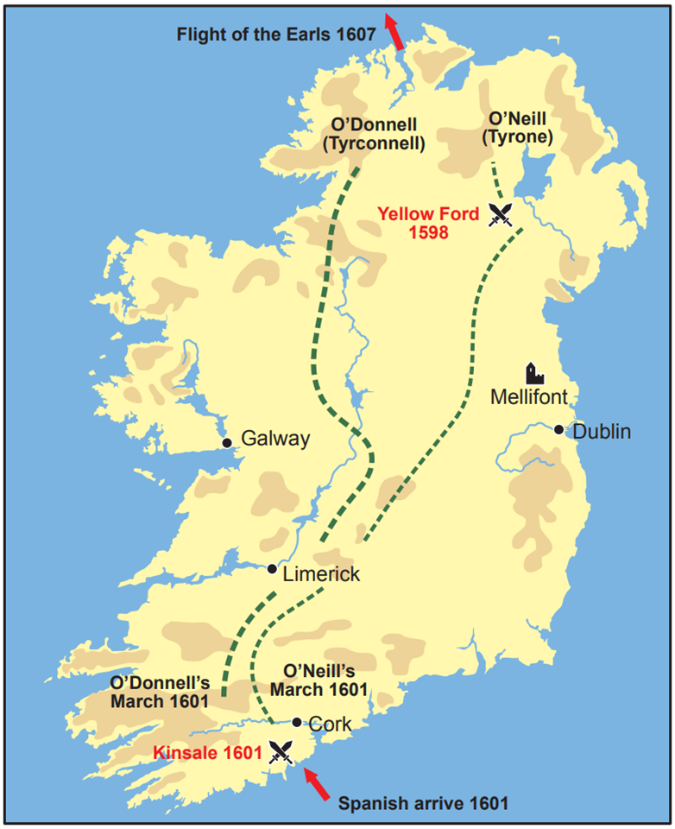
The Nine Years War (1594-1603)
The Gaelic clans in Ulster fought for nine years against the spread of English control. Hugh O’Neill gathered 10,000 soldiers of Ireland and Scotland (gall óglaogh or gallowglasses = foreign soldiers). Hugh O’Neill won several battles, including the Battle of the Yellow Ford in Armagh, which inspired other Irish clans to rebel as well (2,000 English losses versus 200 Irish). King Phillip II of Spain changed his mind and sent 4,000 troops to Kinsale, Co. Cork but were captured by the English. O’Neill and O’Donnell tried to help but were defeated at the Battle of Kinsale by the the 20,000 British troops led by Lord Mountjoy.
Strand Two: The History of Ireland
Chapter Eleven: The Irish Plantations
Diagram taken from Artefact, 2nd Edition by Eimear Jenkinson and Gregg O'Neill (educate.ie)
@MsDoorley

Slide 36
The Treaty of Mellifont (1603)
To end the war, the Ulster Gaelic clans and the English Crown signed the Treaty of Mellifont. This did not stop the English trying to gain control of Ulster as the terms dictated:
  Accept English rule on their land
  Accept English sheriffs and judges in Ulster
  Abandon Irish language and traditions
  No more rebellion
Strand Two: The History of Ireland
Chapter Eleven: The Irish Plantations
@MsDoorley

Slide 37
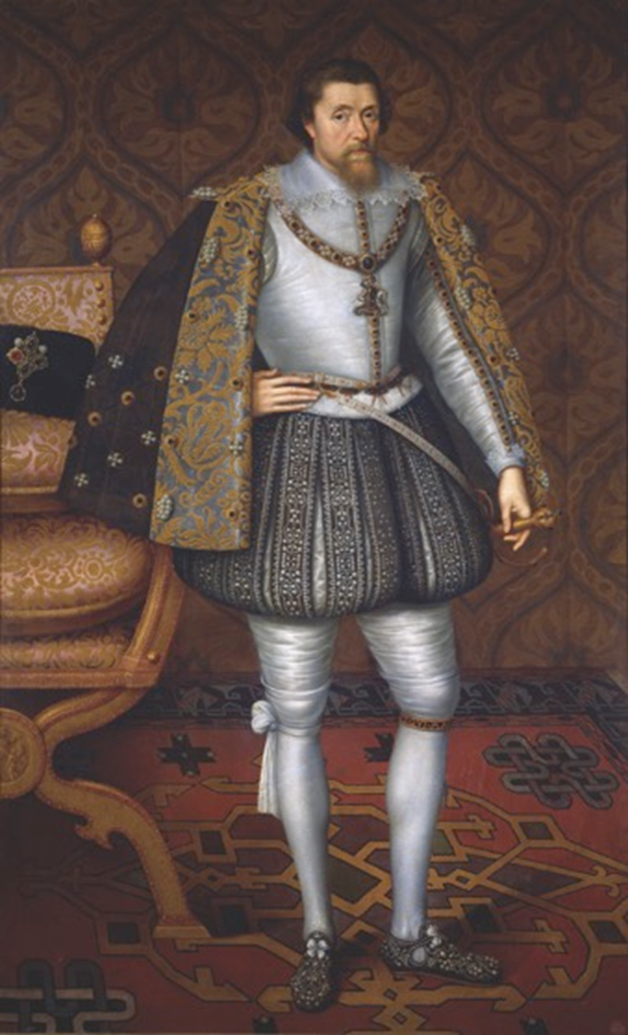
The Flight of the Earls
The Irish Lords were shunned by their people for selling out and for the suffering and starvation during the 9 years war. With no support at home, O’Neill and almost 100 Ulster Irish chiefs fled the country in an event known as the Flight of Earls. They went to Spain and Italy. They had hoped to return with troops but without them, there was no organised resistance to English rule in Ulster. Hugh O’Neill lived out his life as a guest of the Pope.
James I was responsible for the organisation of the Ulster Plantation, having already – and successfully – planted Scotland in a similar manner.
Strand Two: The History of Ireland
Chapter Eleven: The Irish Plantations
Diagram taken from Artefact, 2nd Edition by Eimear Jenkinson and Gregg O'Neill (educate.ie)
@MsDoorley

Slide 38
The Ulster Plantation
•The Ulster Plantation began in 1609.
  Its area covered six counties; Donegal, Derry, Tyrone, Armagh, Fermanagh and Cavan.
  The land was divided into smaller estates than in Munster; none were bigger than 2,000 acres.
  The rules for the planters were more strict than on any of the other plantations.
  Estates were given to three different types of planters: undertakers, servitors, and loyal Irish.
King James reserved the entire county of Derry for London craft guilds, renaming it Londonderry and each section was given a guild. They build two very large towns, Derry and Coleraine. The Gaelic Irish had to live outside Derry’s town walls in a boggy area known to this day as the Bogside (very important when we study the Troubles).
Strand Two: The History of Ireland
Chapter Eleven: The Irish Plantations
@MsDoorley

Slide 39
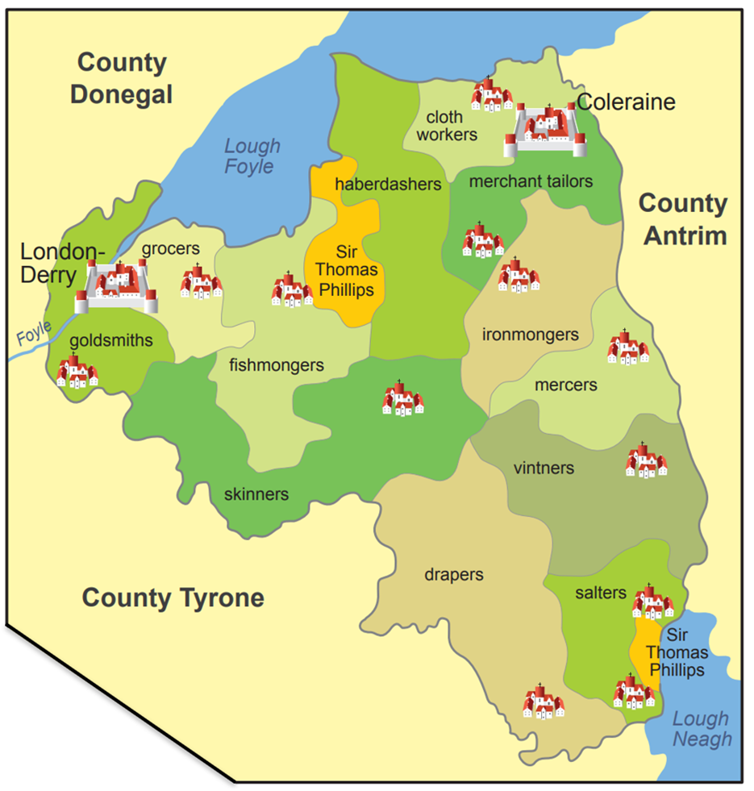
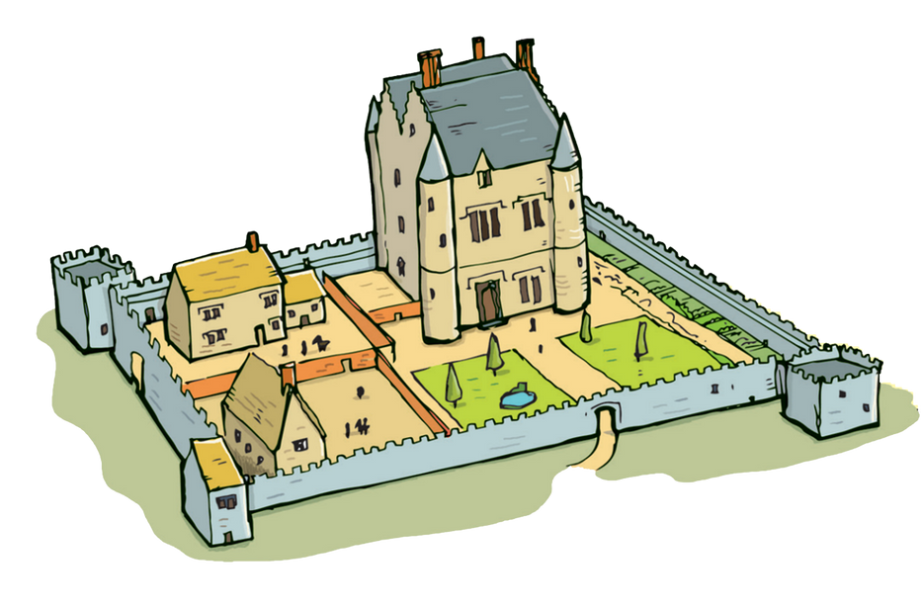
Strand Two: The History of Ireland
Chapter Eleven: The Irish Plantations
Diagram taken from Artefact, 2nd Edition by Eimear Jenkinson and Gregg O'Neill (educate.ie)
@MsDoorley

Slide 40
Types of Planters
Types of planter | Overall % of land | Acres received | Paid King James | Terms and Conditions
Undertakers (English or Scottish men who agreed to do as they were told with the land given to them) | 73% | 2,000 acres | £5 per 1,000 acres every year | They built castles or stone houses with a bawn (courtyard) around them. They could only have English or Scottish tenants.
Servitors (English or Scottish soldiers who had fought for the Crown). | 13% | 1,000-1,500 acres | £8 per 1,000 every year | They also built castles or stone houses. They could have Irish tenants but they had to have strict control over them.
Loyal Irish (native Irish who had stayed loyal to the English during the Nine Years War) | 14% | 1,000 acres | £10 per 1,000 every year | They could rent land to Irish tenants. Servitors kept an eye on them for the Crown.
Strand Two: The History of Ireland
Chapter Eleven: The Irish Plantations
@MsDoorley

Slide 41
The results of the Ulster Plantation
The Ulster Plantation was more successful than both the Laois-Offaly and Munster Plantations.
  A large number of planters arrived in a short space of time; 40,000 of Ulster’s one million population were Scots.
  Due to the high number of settlers, Ulster became the plantation most loyal to the Crown.
  The Protestant religion increased – new religious division within Ulster’s population followed the very same lines as the division between coloniser and colonised that we learned in the Age of Exploration and Conquest.
  The Gaelic Irish were driven off the land they had always held. Tensions between the Catholic natives and the Protestant settlers deepened into hatred and violence from 1609 to the present day.
  Over 20 new towns were founded during the Ulster Plantation and were well planned out.
  Markets were also organised to sell produce.
  English-style houses and stone castles were built on the estates.
  New farming methods were introduced. Crops were favoured over cattle farming.
  While results were mixed, it is clear that the Ulster Plantation was very effective.
Strand Two: The History of Ireland
Chapter Eleven: The Irish Plantations
@MsDoorley

Slide 42
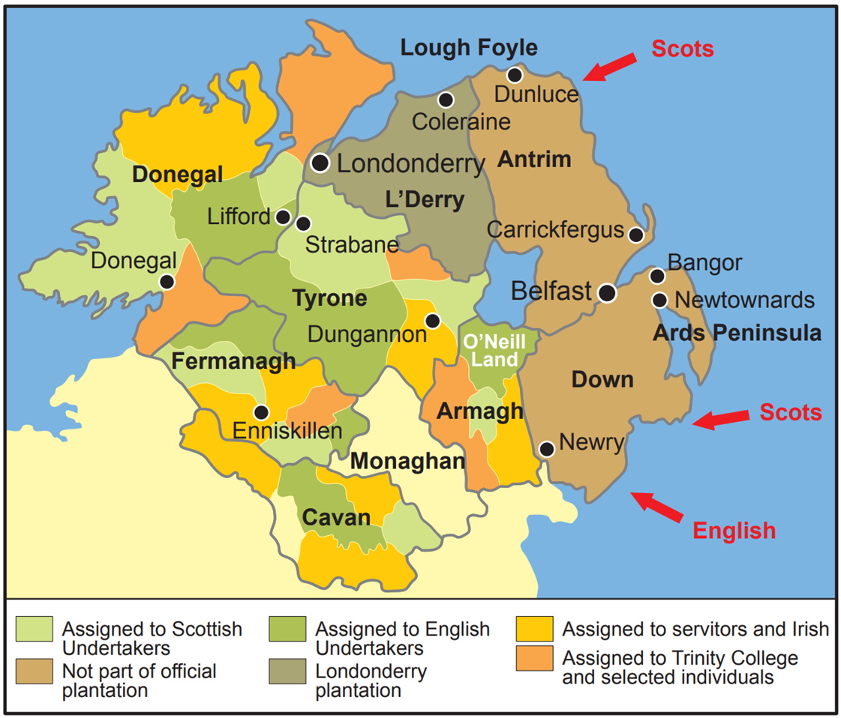
Strand Two: The History of Ireland
Chapter Eleven: The Irish Plantations
Diagram taken from Artefact, 2nd Edition by Eimear Jenkinson and Gregg O'Neill (educate.ie)
@MsDoorley

Slide 43
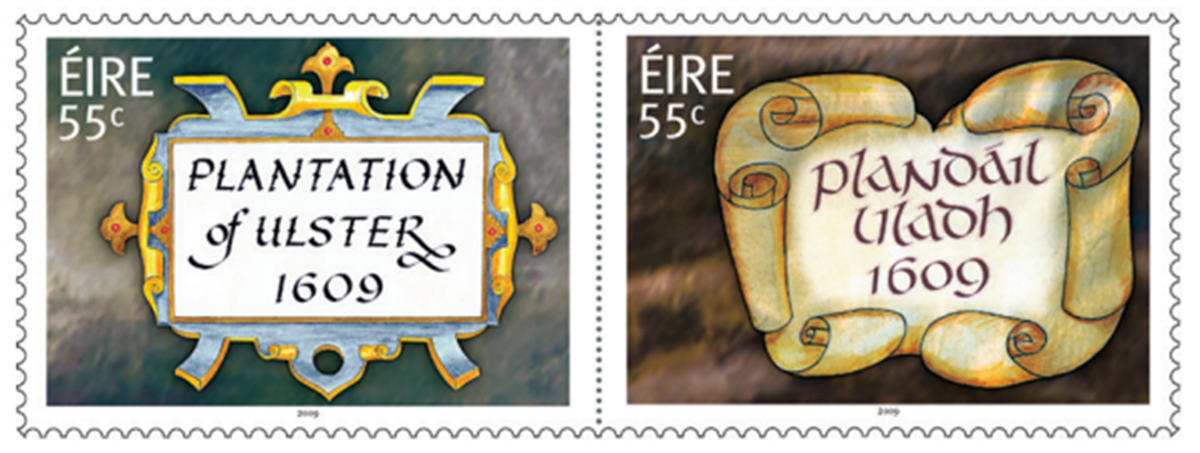
Strand Two: The History of Ireland
Chapter Eleven: The Irish Plantations
Diagram taken from Artefact, 2nd Edition by Eimear Jenkinson and Gregg O'Neill (educate.ie)
@MsDoorley

Slide 44
Checkpoint pg. 125 (Artefact, 2nd Edition)
  What was the Nine Years War?
  Which monarch organised the Ulster Plantation? Why?
  How was Co. Derry’s plantation organised?
  Explain the terms: servitor, Loyal Irish, and the Flight of the Earls.
  Why do you think the Loyal Irish had to pay so much more rent than the undertakers and servitors?
  How did the Ulster Plantation affect (a) population; (b) religion; (c) land ownership?
  After the plantation, what fraction of the population of Ulster were Scottish?
  Name three advances that came to Ulster with the planters.
Strand Two: The Nature of History
Chapter Eleven: The Irish Plantations
@MsDoorley

Slide 45
Checkpoint pg. 125 (Artefact, 2nd Edition)
  The Nine Years War was a war that took place between 1594–1603 when the Gaelic clans in Ulster fought against the spread of English control.
  King James I organised the Ulster Plantation to gain control of Ulster and spread Protestantism.
  Servitor: an English or Scottish soldier who had fought for the Crown; Loyal Irish: native Irish who had stayed loyal to the Crown during the Nine Years War.
  To discourage them from renting land and prevent them becoming economically secure.
  Undertakers. They received at least 500 acres more than the servitors, and at least 1,000 acres more than the loyal Irish.
  (a) Large numbers of English and Scottish settled in Ulster. Of a total Ulster population of 200,000, roughly 40,000 were Scots; (b) The Protestant population increased; (c) The Gaelic Irish were driven off the land they had always held. It was given to loyal planters.
  After plantation, one-quarter of the population of Ulster was Scottish.
  Any three of: new towns were founded and were well planned; English-style houses and stone castles were built; crop farming began to take over from cattle farming; markets were set up in plantation towns.
Strand Two: The Nature of History
Chapter Eleven: The Irish Plantations
@MsDoorley

Slide 46
1500 to 1680
Chapter 11
11.5: LATER PLANTATION
11.5: later plantation
Strand Two: The History of Ireland
@MsDoorley

Slide 47
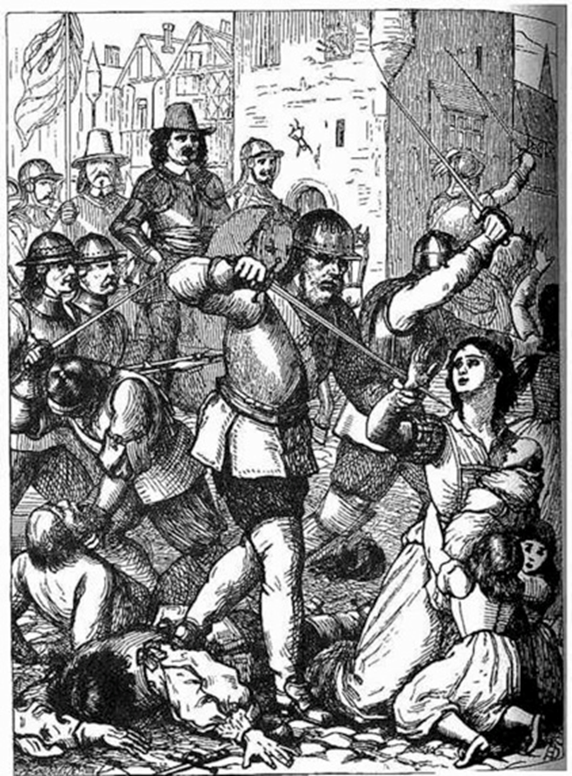
Cromwell's Plantation
•After King James came King Charles I, a Catholic monarch. He was overthrown by his own people and the English Puritan general Oliver Cromwell took over.
In 1641, Ulster Protestants were massacred during a rebellion. Cromwell was ruthless; he arrived in Ireland with his troops to avenge the massacre and end the rebellion. Cromwell reconquered Ireland, executed rebel leaders, confiscated Catholic-owned land across the island to give to Protestant planters and driving the now dispossessed Catholics west.
Strand Two: The History of Ireland
Chapter Eleven: The Irish Plantations
Diagram taken from Artefact, 1st Edition by Eimear Jenkinson and Gregg O'Neill (educate.ie)
@MsDoorley

Slide 48
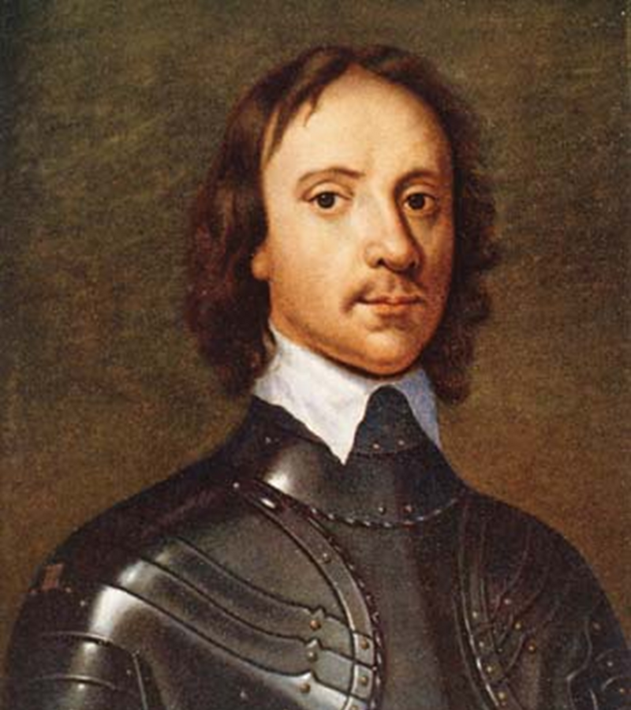
Cromwell’s Plantations
Cromwell’s actions resulted in the deaths of thousands of native Catholic Irish. His troops were called Roundheads because of their helmets.
Those who survived were deported or sent to the worst land, Connaught. (“To hell or to Connaught”)
By 1652, this Plantation had finished what the others had started: very little Irish land remained in Catholic hands.
Strand Two: The History of Ireland
Chapter Eleven: The Irish Plantations
Diagram taken from Artefact, 2nd Edition by Eimear Jenkinson and Gregg O'Neill (educate.ie)
@MsDoorley

Slide 49
1500 to 1680
Chapter 11
11.6: THE IMPACT OF THE PLANTATIONS ON IRISH IDENTITY
11.6: the impact of the plantations on irish identity
Strand Two: The History of Ireland
@MsDoorley

Slide 50
Religious Identity
Prior to the Plantations, Ireland’s ruling social classes, with their various loyalties and customs, were Catholic – the arrival of Protestant English and Scottish planters changed this. Most Catholic Irish owned lands were now controlled by Protestant settlers. In Ireland, the division between coloniser and colonised matched the new religious division. This affected Irish identity very strongly. These effects were felt across Ireland but were most evident in Ulster, where plantation had been most successful.
The majority of Ireland’s population remained Catholic but by 1700, Protestants owned 85% of the land. This wealthy landlord class became the Protestant Ascendency. Anger and mistrust grew between the communities with tensions erupting into terrible violence on both sides. This long history of conflict would eventually develop into the Troubles during the late twentieth century – and still has smaller outbursts to the present day.
Strand Two: The History of Ireland
Chapter Eleven: The Irish Plantations
@MsDoorley

Slide 51
Political Conflict
The power difference between Catholics and Protestants in Ireland led to continued conflict, especially within Politics. Protestants ensured that they held onto their control, wealth and land by introducing the Penal Laws (laws which suppressed the status of Catholics in Ireland) that made it very difficult to escape poverty or achieve security. The first Penal Laws were put in place after the Nine Year War in 1603. These laws greatly affected Irish identity and would go on to shape people’s political beliefs and influence which parties they would support for centuries to come.
Under the Penal Laws, Catholics were forbidden to… | Under the Penal Laws, Catholics were forbidden to…
Buy or inherit land | Marry a Protestant
Keep weapons | Work in the government
Own a horse of good quality | Vote
Run schools or teach | Attend Catholic Mass
Attend the only university (Trinity College) | Miss attending Protestant services
Travel five miles from their home | Employ a Catholic schoolmaster for their Children
Strand Two: The History of Ireland
Chapter Eleven: The Irish Plantations
@MsDoorley

Slide 52
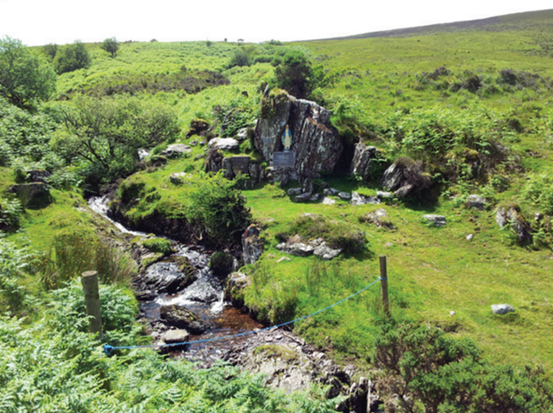
Catholic 'Secret' Actions
Due to the ban on Catholic Mass and the endangerment of Catholic priests, many Catholic parishes had a secret ‘mass rock’ somewhere far from unfriendly eyes. E.g. on a mountain, deep in the woods or tucked into a glen. The people would make their way to this place wherever a priest could appear to say Mass for them, using the rock as his altar. To educate Catholic children, ‘hedge schools’ were set up. Here, they would learn the reading, writing and grammar of the Irish and English languages, along with maths. Oral story telling, history and home economics were also taught in some schools
Strand Two: The History of Ireland
Chapter Eleven: The Irish Plantations
Diagram taken from Artefact, 2nd Edition by Eimear Jenkinson and Gregg O'Neill (educate.ie)
@MsDoorley

Slide 53
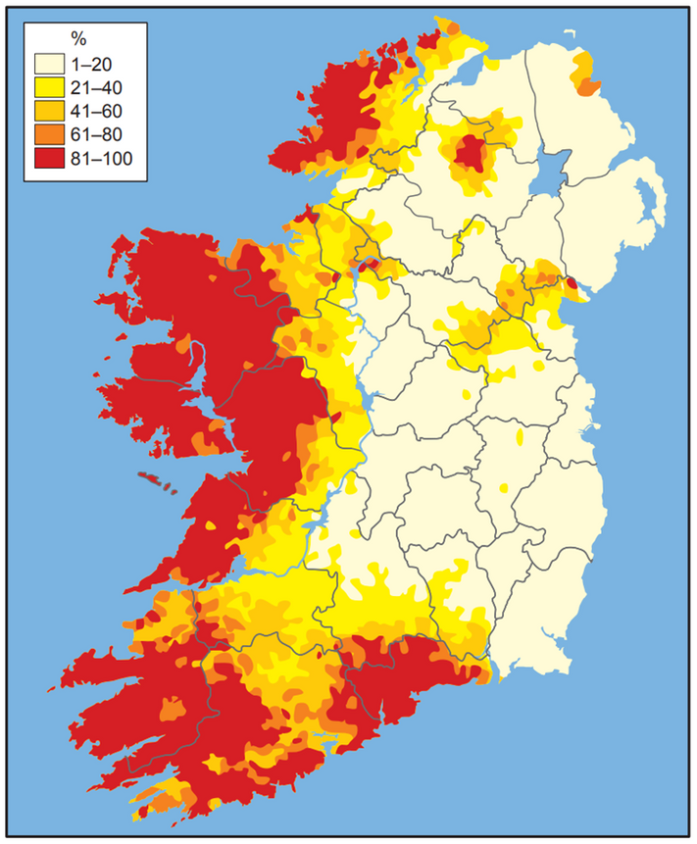
Cultural Change
As the Gaelic chieftains lost power, the culture and language of the Gaelic Irish declined. By 1700, English was already the main language of power and trade. The Gaelic Brehon laws were replaced by English laws. Tillage farming and English methods replaced cattle farming and Gaelic methods. Forests were cleared and land was divided into fields by hedges, ditches or walls. More towns were built, creating a more urban society.
Strand Two: The History of Ireland
Chapter Eleven: The Irish Plantations
Diagram taken from Artefact, 2nd Edition by Eimear Jenkinson and Gregg O'Neill (educate.ie)
@MsDoorley

Slide 54
Checkpoint pg. 127 (Artefact, 2nd Edition)
  Explain the term Penal Laws.
  How did the Penal Laws affect the education that Catholics could receive?
  Give an example of how Irish identity was affected by the Plantations in terms of (a) religion; (b) politics and (c) culture.
  The map above shows where Irish was spoken daily around 1700. Explain why you think it looks like this.
Strand Two: The Nature of History
Chapter Eleven: The Irish Plantations
@MsDoorley

Slide 55
Checkpoint pg. 127 (Artefact, 2nd Edition)
  Penal Laws: laws that suppressed the status of Catholics in Ireland.
  Catholics were forbidden to run schools; forbidden to teach; forbidden to employ a Catholic schoolmaster for their children; forbidden to attend the only university (Trinity College).
  (a) The majority of Ireland’s population remained Catholic, but by 1700 Protestants owned 85% of the land. Anger and mistrust grew between the communities and tensions occasionally erupted into terrible violence on both sides; (b) Protestants ensured that they held on to their control, wealth and land ownership by introducing the Penal Laws. The Protestant/Catholic political divide continued to influence; (c) The English language became the dominant language in most parts of the country; English laws replaced Brehon law; English farming methods replaced the Gaelic ways; forests were cleared and land divided up; Ireland became more urban.
  Areas where the numbers of Irish speakers are the highest are the areas where the Plantations were least successful. Areas with the lowest figures are areas that were successful during the Plantations, along with the Pale, which had originally been loyal to the king.
Strand Two: The Nature of History
Chapter Eleven: The Irish Plantations
@MsDoorley

Slide 56
1500 to 1680
Chapter 11
11.7: THE GROWTH OF TOWNS
11.7: the growth of towns
Strand Two: The History of Ireland
@MsDoorley

Slide 57
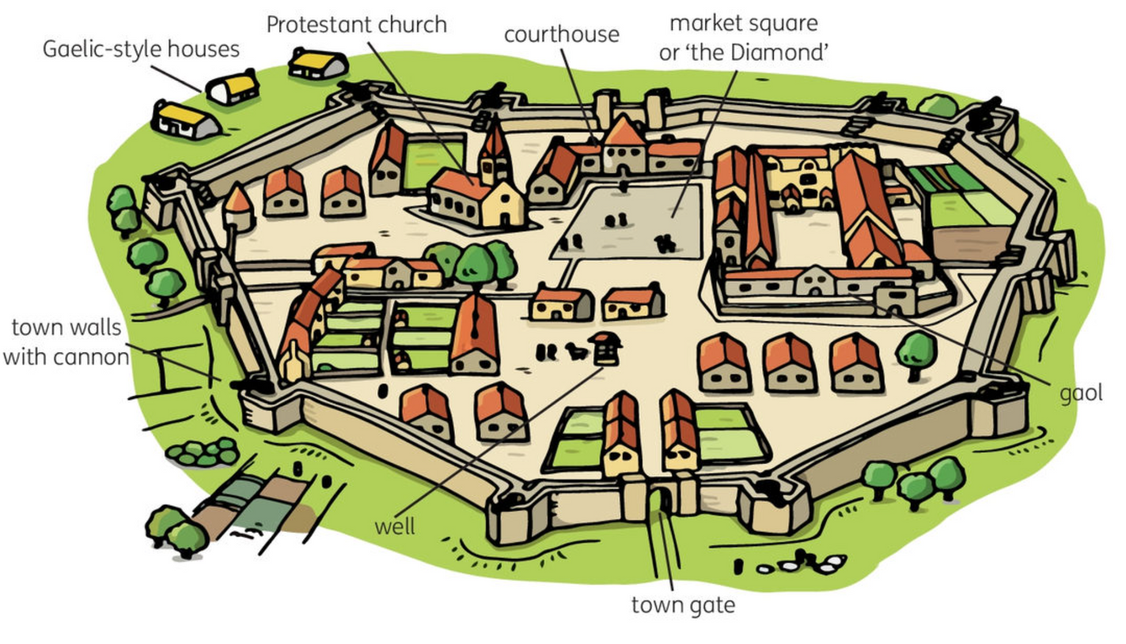
The growth of towns during the Plantations
Many new towns were planned and built during the Plantations, such as Killarney, Portlaoise and Derry. They had a very different layout to medieval towns. Plantation towns were walled and had wide, straight streets, usually laid out around a square where weekly markets were held. In Ulster, this square was usually called 'the Diamond'. Plantation towns had a courthouse, a gaol and a Protestant church. Gaelic-style houses lay outside the town walls.
Strand Two: The History of Ireland
Chapter Eleven: The Irish Plantations
Diagram taken from Artefact, 2nd Edition by Eimear Jenkinson and Gregg O'Neill (educate.ie)
@MsDoorley

Slide 58
The Plantation town of Derry
St Colmcille (Columba) founded a monastic settlement in the sixth century where the town of Derry now stands. In the late sixteenth and early seventeenth centuries, Derry grew rapidly. During the Nine Years War, the English placed a garrison there and Derry was given the status of a city. King James I needed to fund the Ulster Plantation in 1609. He therefore asked the London guilds for finance in return for the county of Derry. The guilds were powerful organisation of tradesmen. Each section of land was given to a guild, for example, tailors, fishmongers or goldsmiths. The London guilds renamed it 'Londonderry' when it was granted a royal charter by King James I in 1613. From 1610 to 1618, the guilds built a fortified city. It was planned in a grid pattern, which remains today, and is best seen from the air. High walls were built around the city to protect it from the Gaelic Irish. A town hall and a courthouse were built. At the centre was a diamond-shaped area, which was easy to defend. Derry is the only remaining inact walled city in Ireland.
Strand Two: The History of Ireland
Chapter Eleven: The Irish Plantations
@MsDoorley

Slide 59


Plantation as a Contentious Issue
The Irish Plantations are an example of a contentious issue, an issue that people are likely to argue about, in Irish history. The Plantations directly contributed to deep religious divisions (especially in Ulster) and a power difference between native Irish Catholics and British Protestant descendants. By the start of the eighteenth century, Protestants owned 85% of land while only making up 15% of the population, leading to growing anger and mistrust with occasional outbreaks of violence.
The Penal Laws of 1603 helped Protestants consolidate their position of power and control as they denied Catholics the opportunity to escape poverty or achieve social/economic security; this discrimination inflicted on Irish Catholics would forever shape their political beliefs in the centuries to follow with the rise of nationalism and unionism. Differences between the two would lead to rising tensions, discrimination, conflict and violence across the island, particularly in Northern Ireland.
Derry became a recurring flashpoint of these increasing tensions and conflicts. The Siege of Derry (1688-1689) saw Protestant supports of King William of Orange resist a siege by the supporters of Catholic King James II; it is still commemorated each year. The 1969 Commemoration of the Siege of Derry would spark three days of rioting that would become known as the Battle of the Bogside – one of the first conflicts of three decades of The Troubles.
Strand One: The Nature of History
Chapter One: The Historian
@MsDoorley

Slide 60
Post-Plantation Growth of Towns
Since the 1700s, Ireland's urban growth has seen two major aspects. Firstly, in rural areas, landowners established towns close to their estates to act as a focal point for markets (where farmers could sell their produce and buy goods they needed). These market towns expanded throughout the 1800s, as first canals and then railways better connected the country. These transport links needed hubs or points of connection, for example Mullingar and Longford. Towns on the coast or a major river were also attractive. Ballina in Co. Mayo was founded in 1729, and its quay for landing ships and the River Moy had a major bearing on its rapid growth and wealth.
Secondly, Ireland's large urban areas and cities expanded. Belfast became the island's industrial heartland from the 1750s on, while Dublin was the seat of government for the Irish parliament (until 1801) and then for the British government in Ireland. This expansion caused huge issues, such as overcrowding in poor housing and mass concentrated poverty.
Strand Two: The History of Ireland
Chapter Eleven: The Irish Plantations
@MsDoorley

Slide 61
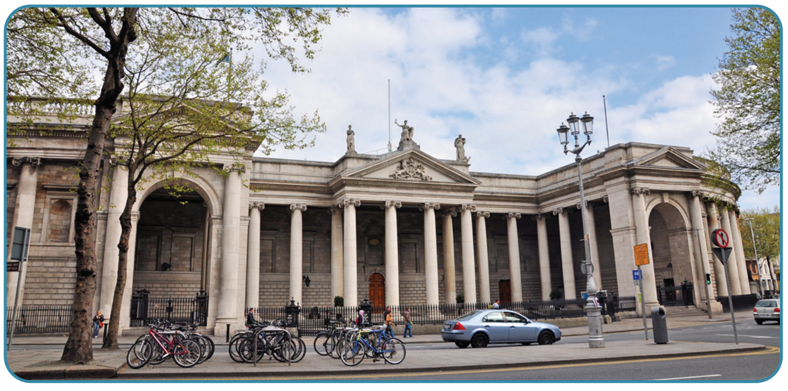
Strand Two: The History of Ireland
Chapter Eleven: The Irish Plantations
Diagram taken from Artefact, 2nd Edition by Eimear Jenkinson and Gregg O'Neill (educate.ie)
@MsDoorley

Slide 62
Checkpoint pg. 130 (Artefact, 2nd Edition)
  Name two plantation towns in Ireland.
  Describe the layout of a plantation town.
  How was Co. Derry's plantation organised?
  Why is the Plantation of Ireland a contentious issue?
  How did towns develop in Ireland after the 1700s?
Strand Two: The Nature of History
Chapter Eleven: The Irish Plantations
@MsDoorley

Slide 63
Checkpoint pg. 130 (Artefact, 2nd Edition)
  Any two of: Killarney, Portlaoise, Derry.
  Plantation towns were walled and had wide, straight streets, usually laid out around a square where weekly markets were held.
  King James I asked the London guilds for finance in return for the county of Derry; each section of land was given to a guild, for example tailors, fishmongers or goldsmiths; the London guilds renamed it ‘Londonderry’ when it was granted a royal charter by King James I in 1613; from 1610 to 1618, the guilds built a fortified city; it was planned in a grid pattern, which remains today; high walls were built around the city; the centre was a diamond-shaped area.
  Differences between Catholics and Protestants a rising from the period of the Plantations continue to lead to tensions, discrimination, conflict and violence, especially in Ulster.
  In rural areas, landowners established towns close to their estates to act as a focal point for markets; these market towns expanded due to canals and railways in the 1800s; Ireland’s larger urban areas and cities expanded; Belfast became the island’s industrial heart land from the 1750s on, while Dublin was the seat of government for the Irish parliament (until 1801) and then for the British government in Ireland.
Strand Two: The Nature of History
Chapter Eleven: The Irish Plantations
@MsDoorley

Slide 64
1500 to 1680
Chapter 11
11.8: SUMMARY
11.8: summary
Strand Two: The History of Ireland
@MsDoorley

Slide 65
In this chapter, we learned that...
  Dublin and its surrounding areas (the Pale) were the base of English power in Ireland.
  The Anglo-Irish and Gaelic Irish owned most of the land.
  The Tudors wanted to expand their kingdom; to make Ireland Protestant; to stop Ireland forming alliances with Catholic monarchs; to impose English customs, culture, laws and so forth on the Gaelic Irish.
  Under 'Surrender and Regrant', local rulers surrendered themselves and their lands to Henry VIII, and he granted their land back to them along with an English title.
  Confiscated Irish land was sold or rented to loyal English settlers. This was known as plantation.
  The first plantation was the Laois-Offaly Plantation, organised by Queen Mary I. The second plantation was the Munster Plantation, organised by Queen Elizabeth I.
  The Ulster Plantation, organised by King James I, was successful. Many English and Scottish planters moved to Ulster and it became loyal to the Crown. The Protestant population grew and prospered, while the Gaelic Irish lost their land. Tensions continue to this day.
  The last plantation was the Cromwell Plantation, organised by Oliver Cromwell.
  Many Irish towns which had been founded as Viking settlements or under the Norman Invasion, continued to develop as a result of the Plantations.
Strand Two: The History of Ireland
Chapter Eleven: The Irish Plantations
Diagram taken from Artefact, 2nd Edition by Eimear Jenkinson and Gregg O'Neill (educate.ie)
@MsDoorley

Slide 66
Reflecting on... Early Christian Ireland
The Plantations influenced identity on the island of Ireland in various ways. Ireland was changed religiously, politically and culturally. The Ulster Plantation, led by James I, was to have the longest lasting effect on the island of Ireland.
Strand Two: The History of Ireland
Chapter Eleven: The Irish Plantations

Slide 67
SEC Examination Questions
Strand Two: The History of Ireland
Chapter Eleven: The Irish Plantations
@MsDoorley

Slide 68
Project
Guidelines:
  Length: The depth of your project should reflect about 2-3 weeks of work.
  Sources: Use at least three different sources for your research. These can be books, scholarly articles, or reputable online resources.
  Citations: All information and images that are not your own should be properly cited.
  Mediums: You may choose to present your project in one of the following ways:
    Poster: Your poster should be informative and visually engaging.
    Minecraft or Lego Model: If choosing this option, please also include a brief report explaining your model.
    Painting/Drawing: Your artwork should be accompanied by a description.
    Recycled Materials: Create your model using recycled materials and provide an explanation of your creative process.
Assessment:
Your projects will be assessed based on:
  Research and Content
  Creativity and Presentation
  Understanding of Context
  Adherence to Guidelines
Strand Two: The History of Ireland
Chapter Eleven: The Irish Plantations
@MsDoorley

Slide 69
Project
Historical Sites
Historical Figures
The Walls of Derry, Northern Ireland
Portadown Fort, Northern Ireland
Donegal Castle, Republic of Ireland
Elizabeth Fort, Cork, Republic of Ireland
Fort Protector, Portlaoise, Republic of Ireland
Queen Mary I
Hugh O’Neill
Randal McDonnell
Charles Mountjoy
William Petty
Queen Elizabeth I
Hugh O’Donnell
Hugh Montgomery
Cahir O’Doherty
King James I
Arthur Chichester
James Hamilton
Viscount de Vesci
Strand Two: The History of Ireland
Chapter Eleven: The Irish Plantations
@MsDoorley

